Slide 1
Five Point Initiative Plan for School Improvement
Atkinson County Middle School
The following report outlines a school improvement Plan for Atkinson County Middle school that addresses deficit Areas outlined by the current ccrpi results.

Slide 2

Atkinson County Middle School
Based on the current CCRPI report Atkinson County Middle School is the lowest performing School in the Atkinson County School District
OVERALL SCHOOL SCORE
62.7

Slide 3
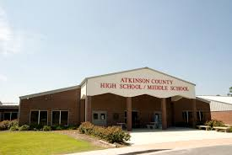
Atkinson County Middle School
Overview:
SCHOOL INFORMATION
NUMBER OF STUDENTS ENROLLED
408
SCHOOL GRADES
06, 07, 08
ADDRESS
145 Rebel Lane
Pearson, GA 31642-5535
DISTRICT WEBSITE
http://www.atkinson.k12.ga.us
TITLE I STATUS
YES

Slide 4
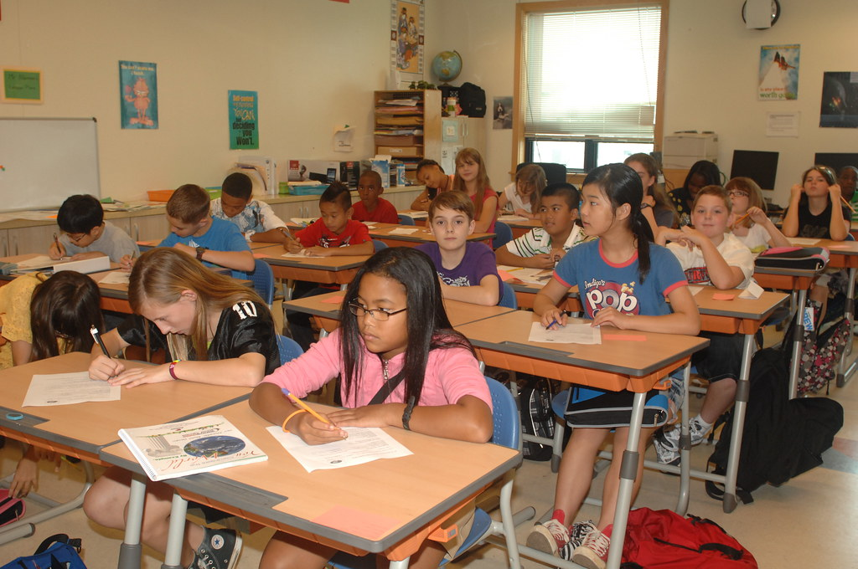
School Demographics
ATCO Middle School
SCHOOL DEMOGRAPHICS
ASIAN / PACIFIC ISLANDER
0.0%
AMERICAN INDIAN / ALASKAN NATIVE
0.3%
BLACK
16.4%
HISPANIC
37.5%
MULTI-RACIAL
1.3%
WHITE
44.6%
ECONOMICALLY DISADVANTAGED
100.0%
ENGLISH LEARNERS
15.3%
STUDENTS WITH DISABILITY
13.7%

Slide 5

HOW DID THE SCHOOL PERFORM COMPARED TO THE STATE?
SCHOOL SCORE 58.2
STATE SCORE 65.1
CONTENT MASTERY
58.2
English Language Arts 62.79
Mathematics 54.55
Science 50.02
Social Studies 63.90

Slide 6



HOW DID THE SCHOOL PERFORM COMPARED TO THE STATE?
SCHOOL SCORE 42.3 Score DID NOT MEET TARGET
STATE SCORE 78.8
Closing Gaps
Subgroups did not make progress and did not meet improvement target
BLACK
ECONOMICALLY DISADVANTAGED
STUDENTS WITH DISABILITY
Closing Gaps sets the expectation that all students and all student subgroups make improvements in achievement rates. This component is based on CCRPI improvement targets for academic achievement, which are represented by improvement flags, and it provides an opportunity for schools to demonstrate the progress made in improving student performance among all student subgroups.

Slide 7

HOW DID THE SCHOOL PERFORM COMPARED TO THE STATE?
SCHOOL SCORE 67.9
STATE SCORE 81.0
HOW DID THE SCHOOL PERFORM ON PROGRESS?
67.9
Progress measures how much growth students demonstrate in English language arts and mathematics and how well English learners are progressing towards English language proficiency.
The English language arts and mathematics indicators utilize Student Growth Percentiles (SGPs) to measure how much growth students demonstrated relative to academically-similar students. English Language Proficiency measures whether students are improving within a performance band or moving up to another performance band, thus moving towards English language proficiency.

Slide 8

Effective school improvement planning models emphasize comprehensive needs assessments, strategic prioritization of needs, an data decision‐making.
Focus on student learning
Incorporate both quantitative and qualitative data: by examining multiple types of data, districts can triangulate their analyses to ensure accuracy.
Experts and secondary research suggest that improvement goals should be rigorous yet attainable.

Slide 9
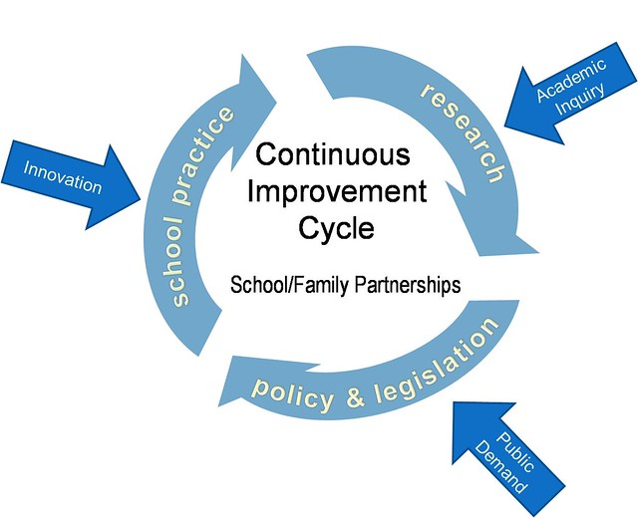
“Not everything that is faced can be changed, but nothing can be changed until it is faced”.
— James Baldwin
DATA Based Issues:
Areas of need in the CCRPI Report
Reading Inventory Scores
ESOL Services
School Facilities
Parental Involvement

Slide 10




Initiative #1
Area of Needs in the CCRPI Report
Deficit areas in Content Mastery and Closing the Gaps:
With a 6.9% difference between the State Average and the School Score in Content Mastery
With a 13.1% difference between the State Average and the School Score of Closing the Gaps

Slide 11
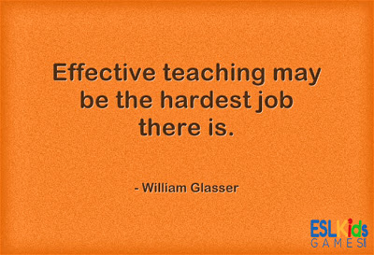
How to improve content mastery and close the achievement gaps?
School Administrators must ensure that Teachers Do the Following:
Hold students to the State Standards for each subject area.
Expect high academic and behavior expectations
Provide students with learning opportunities that meet the needs of all students
Provide instruction and extensive modeling
Promote positive classroom relations for this is the key to motivation and achievement

Slide 12
Addressing the Problem
Improving Content Mastery and the ability to close the achievement Gap has to start in the classroom. In traditional teaching methods, the class learns together and moves on to the next unit when most of the students have achieved mastery. Students who can’t keep up are more likely to develop learning gaps that grow as they are exposed to more difficult material.
It is highly likely at Atkinson County Middle School many students are being left behind because they have not mastered the material presented in class. The subgroups outlined by the CCRPI report showed that Black, Economically Disadvantaged and Students with Disabilities did not meet their learning targets. These subgroups are struggling significantly and some type of improvement plan must be put into place in order to address these issues.

Slide 13
It starts with changing our approach
With a low performing school like Atkinson County Middle School it is vital that all teachers are on the same page when it comes to content and delivery of content material.
In order to track how well each classroom and individual student is performing teachers need to assess students through Formative Pre-Test and Post Test. Collection of this data and analysis of this data will help to inform from week to week what class and what individual students are not mastering the standards taught. This will also allow Teachers to go back and re-teach material when more than 50% of the students are scoring in the deficit area.

Slide 14
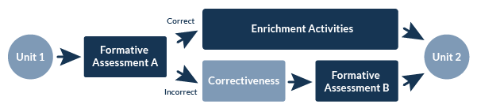
Using Bloom’s System
With this system, educators could be relatively certain there Are no learning gaps that might lead to problems later on. Making sure Teachers re-teach(Correctiveness) or Enrich is essential to Mastery of Content.

Slide 15
Implementation of Initiative #1 and Data Based Measures
Extensive Staff development must be provided through In service Training Days, On going Professional Learning Committees, Grade Level Meetings and Collaboration.
This Initiative can be implemented through updated Curriculum Guides for each grade level that outlines the use of the bloom system.
Assessment of strategies can be Measured through the Teachers Keys Platform.
Formative and Summative Assessment will determine whether this Initiative is successful

Slide 16

Initiative #2
Improvement of Reading Scores
Many educators believe the reason students continue to struggle with reading is because Schools usually focus on teaching comprehension skills instead of general knowledge.

Slide 17
Here lies the gap
According to the Georgia Department of education Georgia students’ scores on the 2019 National Assessment of Educational Progress (NAEP) were on par with the national average and stayed steady compared to 2017.
So why do schools like Atkinson County Middle school have such deficits in Reading?
Looking at the data atkinson County Middle school has a 100% Economically Disadvantaged Students and 37.5% Hispanic Students many who have just arrived in this country.

Slide 18
Look at the Facts on Reading
98% of reading is an auditory. Only 2% of reading is visual.
Seven out of eight students with reading problems in first grade continue to struggle.
Listening skills (including phonemic awareness, auditory attention, auditory sequencing, and listening vocabulary are the most important factors in natural reading.
The biggest barrier to comprehension is lack of fluency. Less than 15% of learning disabled students have comprehension problems if they read accurately and read faster than 80 words a minute.
English is the most difficult major language to listen and to read. For struggling readers, listening to English can be like listening to a foreign language you haven’t quite mastered.
The main reason English is so difficult to speak, listen to and to read is because spoken English has an exceptional number of vowel sounds (phonemes). The ability to hear and identify individual sounds is what separates natural readers from struggling readers. Many weak readers struggle with spelling and most of their errors – not surprisingly — are with vowels.
Students who read at a lower grade level are at serious academic risk.
Retrieved from: https://soundreading.com/

Slide 19
Must Attack with a Plan
Have a Plan:
Ensuring the Plan:
1. . Atkinson County Middle School must adopt a consistent Reading Program that focuses on literacy.
2. They must establish clear short and long term goals for each grade, class and level.
3. Enlist the support of Reading Specialist or Hire a Reading Specialist for each Grade Level to help implement the program with validity.
4. Administrators must monitor this program to ensure implementation is successful.
5. Celebrate small milestones through rewards and incentives for students and teachers.
6. Use data to guide instruction and lead the charge for change.
1. Provide support for teachers and personnel.
2. Be sure all teachers/staff share the common vision and mission for improving reading.
3. Provide staff development and training.
4. Recruit volunteers from the community to help implement the program and to help provide incentives.
5. Increase and support reading time as “precious time” set aside in each school day. Use slogans for example: Drop Everything and Just Read!
Run the Race of Reading!
6. Make it FUN!

Slide 20
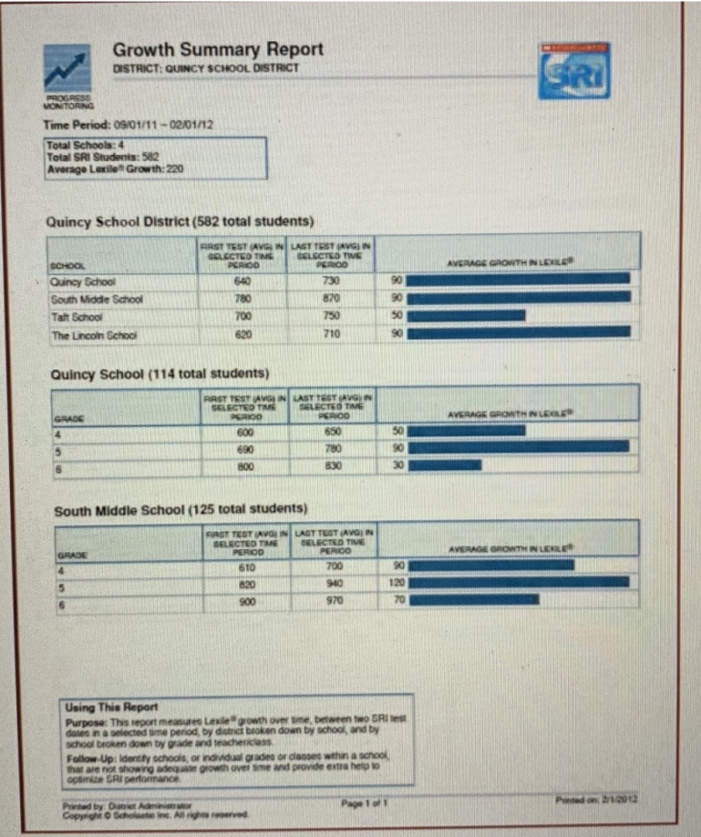
Data Based Measures to Determine Success
Student Summary Growth Chart Example
Atkinson County Middle School will use The Reading Inventory for Data Collection and to monitor growth of their students.
The Reading Inventory is a classroom-based reading test. The Reading Inventory is designed to evaluate students’ reading abilities, monitor student reading progress, set goals for reading growth, and match students to books at appropriate reading levels.
The Reading Inventory generates a Lexile score each time it is completed.
Students will be tested three times per year and the student growth summary will prove whether this initiative is successful.

Slide 21
Initiative #3
Revamp ESOL Services
Atkinson County Middle school has a high population of Hispanic Students-37.5%
Many of these students have just arrived from countries such as Mexico, Guatemala, Dominican Republic, El Salvador, Nicaragua and Honduras.
These students enter the school system with extreme Language barriers and the school only has one eSOL Teacher employed to service both the Middle and High school.

Slide 22
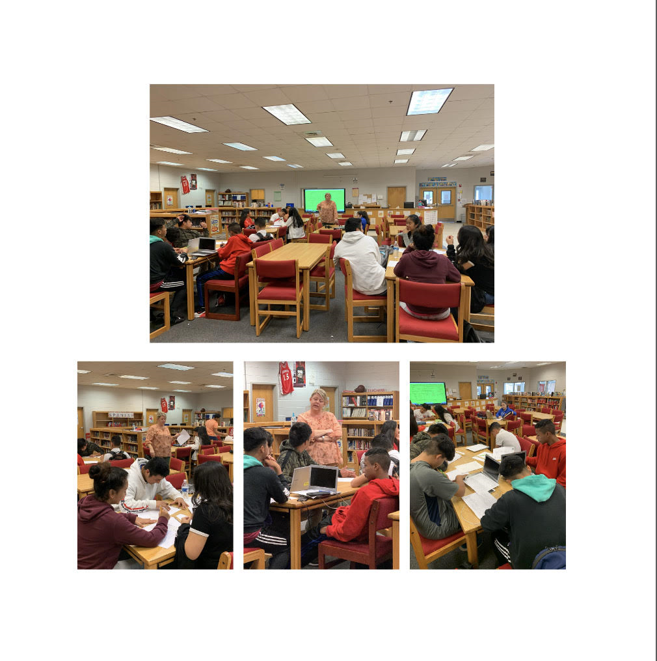
ESOL Guidelines
ESOL Class
English to Speakers of Other Languages (ESOL) is a state funded instructional program for eligible English Learners (ELs) in grades K-12 (Georgia School Law Section 20-2-156 Code 1981, Sec. 20-2-156, enacted in 1985).
Title III is a federally funded program which provides eligible Local Education Agencies (LEAs) with subgrants to provide supplemental services for ELs. Both ESOL and Title III hold students accountable for progress in English language proficiency and evidence of attainment of English language proficiency sufficient to exit ESOL services.

Slide 23
Where Are We Now
The ESOL Program is a standards-based curriculum emphasizing social and academic language proficiency. The curriculum is based on the integration of the WIDA Consortium English Language Proficiency Standards with the Georgia Standards of Excellence.
This integration will enable English Learners (ELs) to use English to communicate and demonstrate academic, social, and cultural proficiency. It is critical that instructional approaches, both in ESOL and general education classes, accommodate the needs of Georgia’s ELs. To the extent practicable, it is appropriate to use the home language as a means of facilitating instruction for ELs and parental notification
Only one ESOL Certified Teacher services all ESOL Students at Atkinson County Middle and Atkinson County High School regardless of their Language ability.
The Middle and High School classes are combined and instruction is held in the media center.
This is not an ideal situation for the students or the ESOL Teacher.

Slide 24
Establishment of Vision and Goals
Vision:
Ensure that all ESOL Students of atkinson County Middle school receive the respect, encouragement and opportunities they need to build the knowledge, skills and attitudes to be successful, contributing members of a global society.
Goals:
Value and build upon students' academic, linguistic, and cultural backgrounds.
Create a supportive learning environment.
Assist students in reaching their full academic potential.
Build connections between ESOL and school wide instructional programs.
Encourage participation of students and their families within the school and the community.
Foster understanding and appreciation of diverse populations within the school and the community.

Slide 25
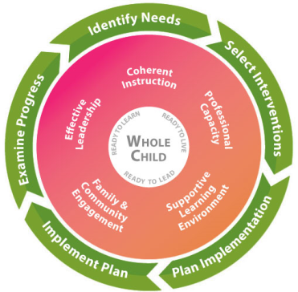
ESOL Instructional Delivery Model
There are six state approved instructional models through which ESOL students are served.
Atkinson County Middle School uses the
Pull-out model. Students receive Instruction one block per day in a class called Reading and Listening.
This is a great delivery model however, more certified ESOL instructors are needed to address the numbers and needs of the students at atkinson County Middle School.
The state of Georgia uses Formula Funding:
Teacher allocations account
for ELLs in their state’s primary funding formula through staffing costs. Under this formula based on Atkinson County Middle School ESOL numbers an additional ESOL Teacher Should be hired.

Slide 26
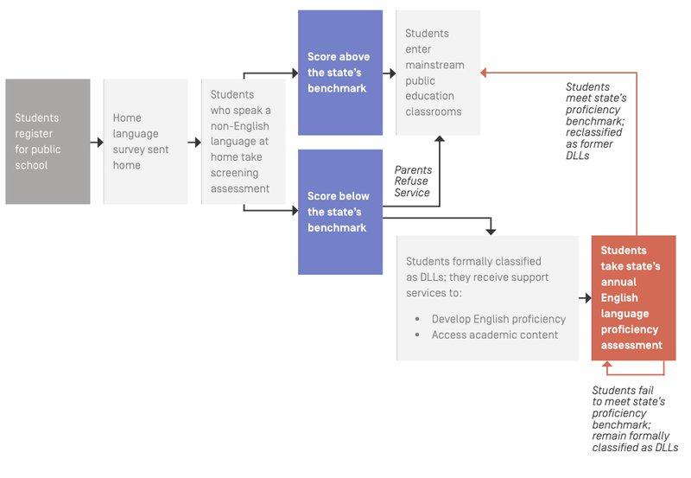
Data Based Measures for ESOL Program
Retrieved from: https://www.newamerica.org/education-policy/edcentral/totalenglishlearners/

Slide 27
Data Based Measures for ESOL and Success of Initiative #3
An increase in student achievement on formative and Summative Assessment.
2. Digital Student Portfolio Tool
A digital student portfolio is a collection of evidence, created by the student, that shows her or his work in descriptive context. This can serve as a qualitative indicator of student learning for teachers, i.e., it shows creativity and/or analysis of the words. It can also provide evidence that the teacher and school/district are making concrete efforts to aid special populations, as required by law.
These two measures will show evidence of the success of Initiative #3.

Slide 28
Initiative #4 School Facilities
Atkinson County Middle School being a school that serves economically disadvantaged students and is located in a rural area of Georgia with very little tax base will need Grant money to meet the needs of their students.
A grant Writing Initiative needs to be established in order to secure the much needed resources to improve the Middle schools' Facilities.
Grants that the Middle school could look into for example:
L4GA Grant Basics
SIG Schools (School Improvement Grant SIG 1003(g) Schools)
Many Grants Promise to improve student literacy learning, teacher delivery of instruction, school climate, and academic outcomes across all sub-groups of children, from birth to grade 12.”

Slide 29
Getting Ready to Write a Grant
The Grants Program Unit of the Georgia Department of Education's Title I Programs Division administers several federal formula and competitive grant programs.
Formula Grants are awarded to the Department of Education based on a predetermined formula (population, other factors). Formula-driven grants are passed on to local agencies and organizations via subgrants.
Competitive Grants are awarded to the the Department of Education who, in turn, awards grants on a competitive basis, consistent with congressional earmarks, to public and private nonprofit organizations
-Retrieved from:. Grantshttps://www.gadoe.org/School-Improvement/Federal-Programs/Pages/Outreach-Overview.aspx

Slide 30
Getting Started
Assemble a Proposal Preparation Team
identify the persons and their role and how they will be vital to the participant in preparing and submitting a grant proposal
For example: Most Proposal teams are comprised of administrators, Teachers, Support Staff and Community Members
3. Reason for The Grant: What are the components of the project? How will you justify the requested funding? What are your long term goals and expected outcomes, and how will you evaluate them?
Establish a time line.
Collaboration is a key component for successful Grant Writing.

Slide 31
Measure of Success
If Atkinson County Middle school is rewarded the Grant and the use of funds is put into the appropriate areas success will be forthcoming.

Slide 32
Initiative #5 Parental Involvement
Ongoing research shows that family engagement in schools improves
student achievement, reduces absenteeism, and restores parents' confidence in their children's education.
Retrieved from:
http://neatoday.org/2014/11/18/the-enduring-importance-of-parental-involvement-2/

Slide 33
Atkinson County Middle School Parent Coordinator
The Atkinson County Parent - Family Engagement Coordinator provides information and resources to assist families with helping their children increase their academic achievement. Atkinson County High School, Atkinson County Middle School, Pearson Elementary School, and Willacoochee Elementary School are school-wide Title I schools.
Families are invited to provide suggestions and ideas to improve our Title I programs and plans. Together...we can make a difference!
Email: mgiddens@atkinson.k12.ga.us

Slide 34
Parent Links
Parent Links
A Family's Guide to Title I
A Family's Guide to Title I Spanish Version
ATKINSON COUNTY DISTRICT TESTING CALENDAR 2019-2020
Atkinson County Family Connection Facebook Page
Atkinson County High School Stakeholder & Parent/Guardian Input Form
Atkinson County Middle School Stakeholder & Parent/Guardian Input Form
Atkinson County Report Card- District and Schools
Atkinson County Schools Parent-Family Engagement Facebook Page
GADOE Family-School Partnership Program
Georgia Parent Survey School Year 2019-2020
Georgia School Grades Reports
Georgia Sex Offender Registry
Governor's Office Of Student Achievement Report Card
Infinite Campus Parent Portal
Information for Parents
Parent And Family Engagement Survey
Parent Engagement Resources
Pearson Elementary School Stakeholder & Parent/ Guardian Input Form
Renaissance Home Connect
School Contact Information
School Nutrition Menus
SLDS Parent Portal Guide
Southeast Health District Website
Technology Links

Slide 35
Lack of Parent Involvement
Atkinson County has One Parent Coordinator for all four Schools in their District. Reaching parents is a daunting task and one person having to take on this responsibility can be overwhelming.
She provides an array of information on the school’s web site and facebook page.
Are Parents accessing this information?
How helpful is this information to them?
Most importantly do the parents understand the information presented?

Slide 36
Building a Meaningful and Comprehensive Parental Involvement Policy for Atkinson County Middle School
Atkinson County School District has a Parental Involvement Policy however, this Initiative will put focus on the needs of parent involvement at the middle school level.
Putting a Plan in place that is purposeful and proactive to address the unique needs of middle school students and parents is vital to seeing an increase in parental involvement.

Slide 37
If schools want parents to care…
The School must demonstrate they Care about Parents
Involve parents in the planning, review, and improvement of the school’s parental involvement policy. Have Parents volunteer and sign up per class. BE sure to have equal representation per grade level.
Invite parents to meetings. Arrange for door prizes and incentives for them giving of their time.
Listen to their ideas and their concerns.
Support parents: provide full opportunities for the participation of parents with limited English proficiency, parents with disabilities, and parents of migratory children, in a format that is practicable and in a language that parents can understand.

Slide 38
Data Based Measures to Determine Success:
Surveys and Questionnaires
Increase participation in parent meetings

Slide 39
Five Point Initiative Plan Highlights
1. Areas of need in the CCRPI Report
Change begins in the classroom through the use of Bloom’s System & Teacher Training Strategies to address Mastery of Content and Help Close the Gap.
2. Improve Reading Scores
Increase scores by adopting a school wide reading program and implementing it with vitality.
3. Hire additional ESOL Teacher to service only Middle School Students.
Improve School Facilities by Grant Writing
5. Increase Parental Involvement by involving Parents and providing incentives for them to participate.
1.

